Slide 1
Pembelajaran Mesin dan Pembelajaran Mendalam #6 Convolutional Neural Network
Semester Gasal 2024/2025
Prodi Informatika
Universitas Atma Jaya Yogyakarta

Slide 2
Outline
Convolutional Neural Network
CNN Layers
CNN Models' Architecture

Slide 3

Convolutional Neural Networks

Slide 4
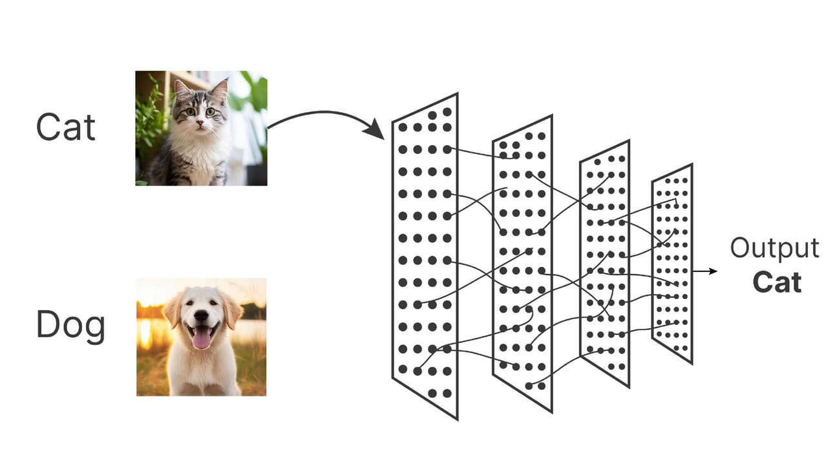
CNN
Convolutional Neural Networks, Simplified

Slide 5
CNN
The CNN family of models was initially inspired by the way the human brain's visual cortex processes and identifies items.
To classify handwritten digits from photographs, Yann LeCun and his colleagues presented a revolutionary NN architecture in the 1990s, which is when CNNs were first developed.
This Feedforward NN attracted a lot of attention due to CNNs' exceptional performance on image classification tasks, to the great advantage of machine learning for computer vision.

Slide 6
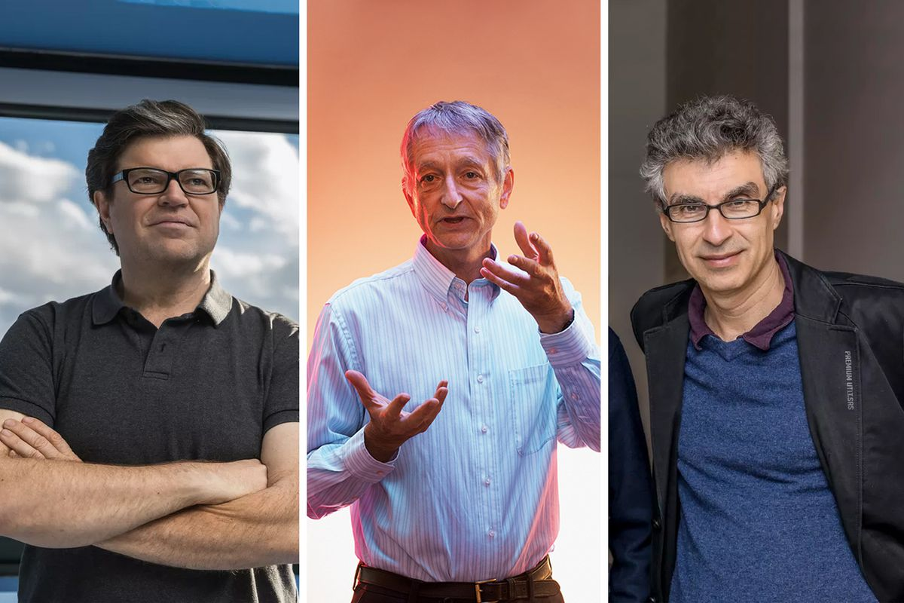
CNN
A few years later, in 2019, Yann LeCun and two other researchers, Yoshua Bengio and Geoffrey Hinton, were given the Turing prize, the most prestigious honor in computer science, for their contributions to the field of artificial intelligence (AI).
Yann LeCun
Geoffrey Hinton
Yoshua Bengio
This Photo by Unknown Author is licensed under CC BY-SA

Slide 7
CNN vs Conventional ML Models
Conventional machine learning models rely on input characteristics that are either derived via computational feature extraction techniques or may come from a domain expert.
Some neural network architectures, like CNNs, have the ability to automatically identify from unprocessed input which properties are most relevant to a given task.
CNN layers are frequently thought of as feature extractors: the early layers (those that come directly after the input layer) use the raw data to extract low-level features, and the later layers (usually fully connected layers, like in a multilayer perceptron (MLP)) use these features to predict a continuous target value or class label.

Slide 8
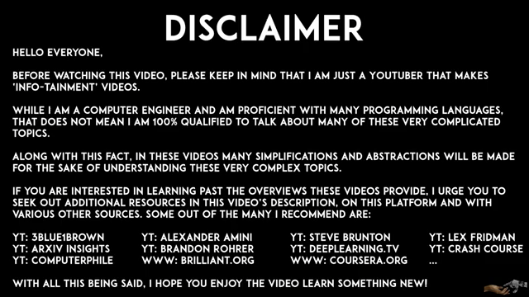
Convolutional Neural Networks Explained
https://youtu.be/pj9-rr1wDhM?si=JxpupZ-fKHZt-mns

Slide 9
CNN
A so-called feature hierarchy is created by several multilayer NN types, especially deep CNNs, which combine low-level features layer by layer to create high-level features.
When working with photos, for instance, low-level characteristics like edges and blobs are taken out of the earlier layers and integrated to create high-level features.
More intricate shapes, such as the overall outlines of things like houses, dogs, or cats, can be formed using these high-level features.

Slide 10
CNN
CNNs typically exhibit exceptional performance on problems involving images, mostly attributable to two key concepts:
Sparse connectivity: Only a little region of pixels in the feature map is related to a single element. (In contrast to connecting to the entire input image, like with MLPs, this is substantially different).
Parameter sharing: Different input image patches are assigned the same weights.

Slide 11
CNN
CNNs are usually made up of multiple convolutional and subsampling layers, with one or more completely connected layers at the end.
In essence, the fully linked layers comprise an MLP, in which each input unit (i) is connected to each output unit (j), each of which has weight W(ij).
It should be noted that subsampling layers, sometimes referred to as pooling layers, lack any learnable characteristics. For example, pooling layers don't contain any weights or bias units.
Nonetheless, training optimizes the weights and biases of the convolutional and fully connected layers.

Slide 12
CNN Layers

Slide 13
CNN layers
Convolution layer, pooling layer, and fully connected layer are the three types of layers in CNN.
A convolution network's essential component is its convolution layers. Convolution works with what's known as a filter or kernel.
A kernel is a small matrix of adjustable weights. During training, these weights are modified to help the network learn important features for the task at hand.
Neurons in the convolution layer are made up of width, height, and depth (W, H, D).

Slide 14
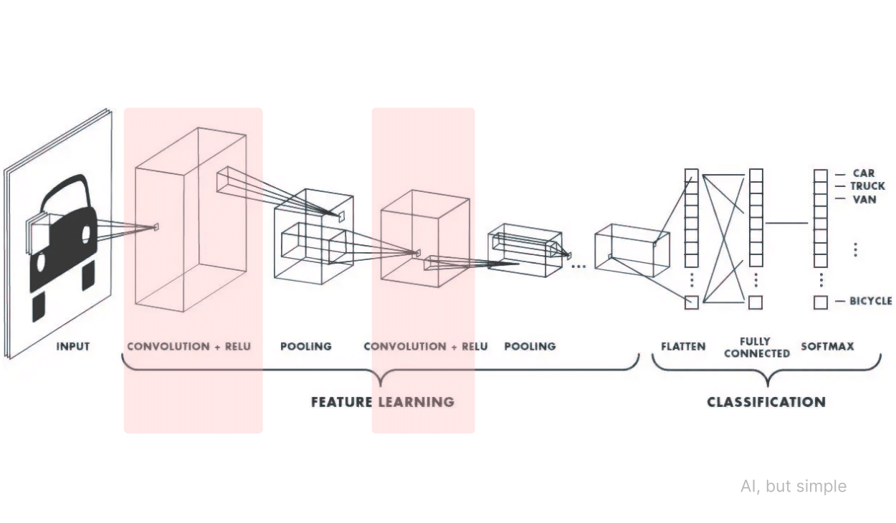

Slide 15
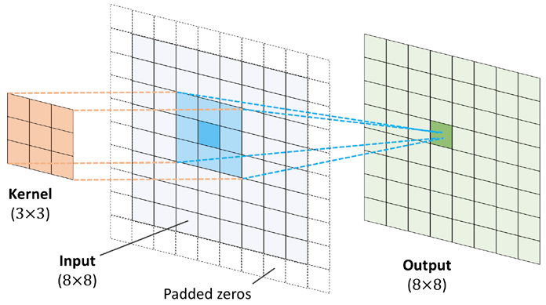

Convolution Layer
When the stride is set to 1, the filter moves one pixel at a time, both horizontally and vertically.
When the stride is greater than 1, the filter skips some positions as it moves across the input image. (makes the feature map smaller)
In the gif, the stride is 2.
Convolutional Neural Networks, Simplified

Slide 16
Convolution Layer
At each position, the kernel performs an elementwise product between its weights and the corresponding values of the input data, followed by summing the result to get a single value.
After sliding the kernel across the entire image, it produces a two-dimensional representation known as a feature map, which shows the importance of each region of the image.
Since convolution is a linear operation and images are non-linear, activation functions (such as ReLU and its variations) are used after the convolutional layer to introduce non-linearity to the feature map, facilitating faster convergence and better learning.

Slide 17
Convolution layer calculation example
Convolution layer requires 4 hyperparameters
i. Number of Filters (K)
ii. Shift of per pixel (S)
iii. Filter Size (F)
iv. Lots of zero padding (P)
Input from Convolution Layer W1×H1×D1
Produces W2×H2×D2
W2=((W1−F+2P)/S) +1
H2=((H1−F+2P)/S) +1
D2=K

Slide 18
Convolution layer calculation example
Input Volume =>
W1=5,
H1=5
D1=3
HyperParameters =>
K=2
F=3
S=2
P=1
Explanation :
There are 2 Filters (K == 2)
With size 3 x 3 (F == 3)
Stride 2 (S == 2)
Padding 1 (P == 1)
Output =>
W2 => ((5-3+2)/2) + 1 == 3
H2 => ((5-3+2)/2) + 1 == 3
D2 => K == 2

Slide 19
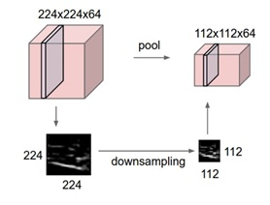
Pooling layer
The pooling layer functions to reduce spatial size by using downsampling techniques. This is done to reduce the computational workload and prevent overfitting.

Slide 20
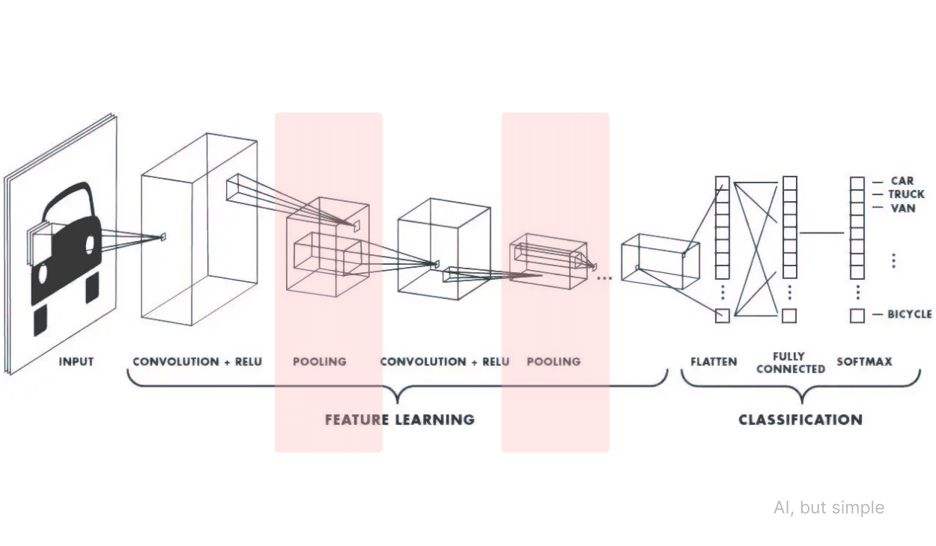

Slide 21
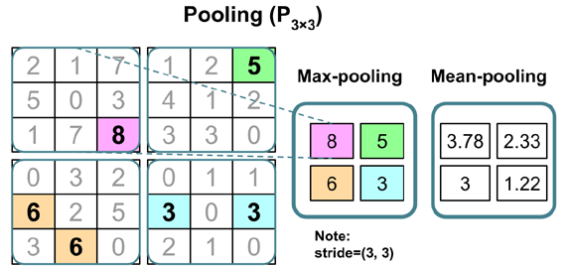
Pooling layer

Slide 22
Pooling layer calculation example
Receives input in the form of W1×H1×D1
Requires 2 Hyper Parameters
i. Filter Size (F)
ii. Shift (S)
Generate W2×H2×D2 with the formula
o W2=(W1−F)/S+1
o H2=(H1−F)/S+1
o D2=D1

Slide 23
Pooling layer calculation example
There are 2 functions in the pooling layer
1. Average Pooling: average value for each patch on the feature map.
Calculation :
Patch (Orange) => (3 + 1 + 2 + 5)/4
Patch (Blue) => (1 + 3 + 0 + 2)/4
Patch (Gray) => (1+4+4+7)/4
Patch(Yellow) => (2+1+2+4)/4

Slide 24
Pooling layer
2. Max Pooling: calculates the maximum value for each patch on the feature map.

Slide 25
Fully Connected Layer
Fully Connected Layer is a layer used to carry out transformations on data dimensions so that data can be classified linearly.
Fully Connected Layer is the last layer of a neural network.
Input is the flattened output from the pooling/convolution layer.
Flattened is a vector value resulting from pooling and convolution layers in the form of a 3-dimensional matrix (Tensor)
After going through the Fully Connected layer, this layer uses the softmax Activation function to get for each class (classification)

Slide 26
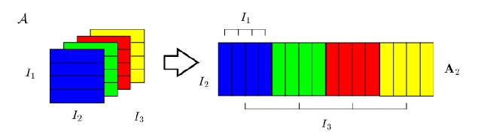
Fully Connected Layer

Slide 27
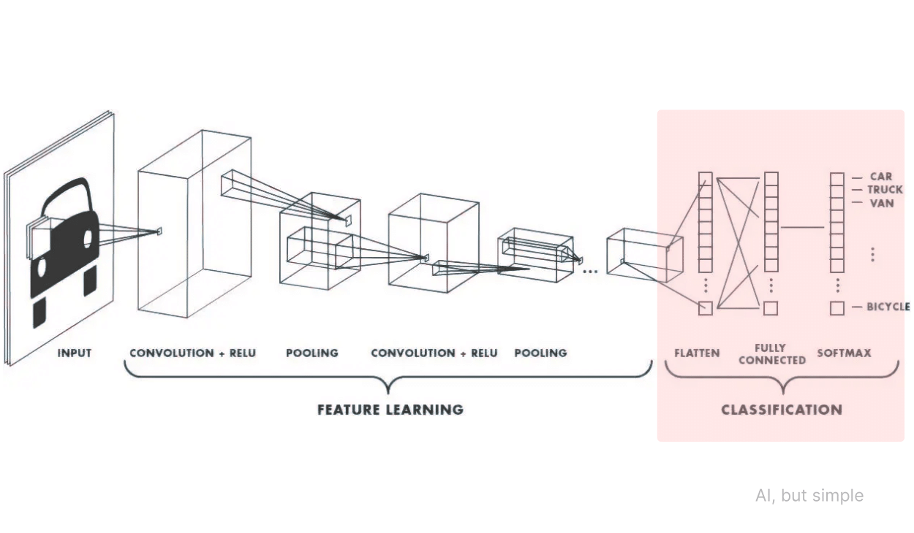

Slide 28
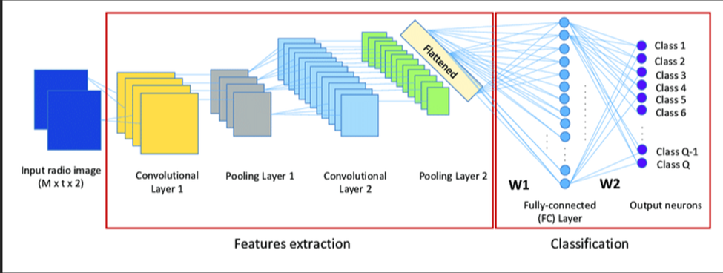
CNN illustration

Slide 29
CNN Models' Architecture

Slide 30
CNN Models
LeNet
In 1998, Yann LeCun et al created 7-level convolutional network, LeNet-5 to detect handwritten digits on 32x32 pixel grayscale images2.
The architecture of the network is comprised of two sets of average pooling and convolutional layers, a flattening convolutional layer, two fully-connected layers, and a softmax classifier.
The network's loss function is cross-entropy, and its activation functions are sigmoid or tanh.
Additionally, weight decay and subsampling are used to lower computational cost and overfitting.

Slide 31
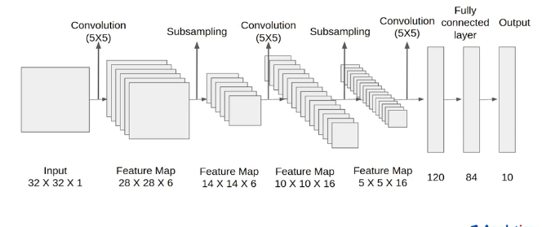
CNN Models

Slide 32
CNN Models
GoogLeNet
Inception modules: made up of a max pooling layer and parallel convolutional filters of various sizes. The network may learn features at different scales and with fewer parameters thanks to the inception module.
1x1 convolutions: To lower the dimensionality of the feature maps and boost computational performance. As bottleneck layers, the 1x1 convolutions compress the data before sending it to the following layer.
Uses a global average pooling layer to replace the fully connected layers at the end of the network. This layer averages each feature map and produces a single value.
A softmax classifier that forecasts the class probabilities makes up the final output layer.

Slide 33
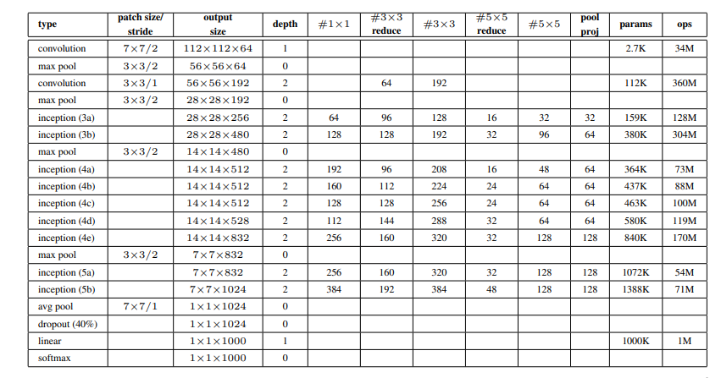
CNN Models-GoogleNet

Slide 34
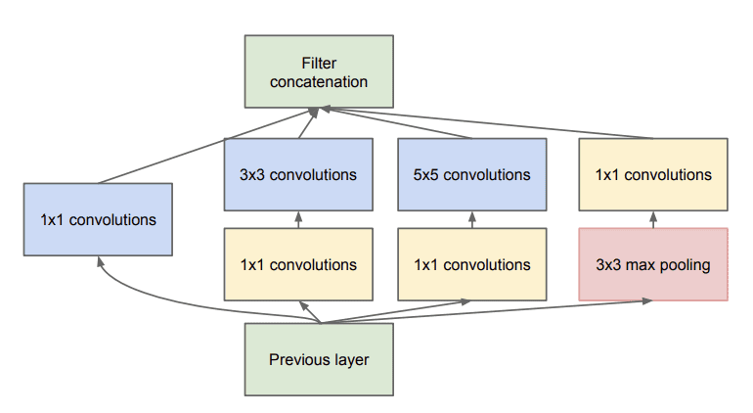
CNN Models-GoogleNet Inception Module
Example of the Inception Module With Dimensionality Reduction Taken from Going Deeper with Convolutions, 2014.

Slide 35
CNN Models
AlexNet
AlexNet took first place in the 2012 ImageNet competition with a top-5 error of 15.3%, which was far less than the previous record.
Made up of eight layers: three fully connected layers, five convolutional layers, and max-pooling layers in order of precedence.
Rectified linear units (ReLU) are used as dropout layers and activation functions in the network to avoid overfitting.
AlexNet is divided into two parallel streams, with a different GPU for each, in order to minimize the computational and memory demands.
Used to detect large-scale images

Slide 36
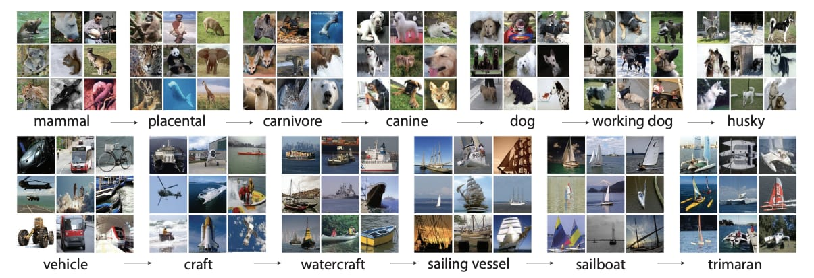
ImageNet dataset used for the challenge contained 150000 images and 1000 categories
Modern Convolutional Neural Network Architectures

Slide 37
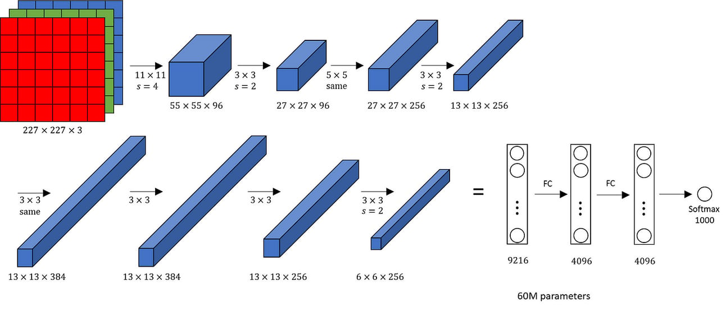
CNN Models-AlexNet Architecture
Modern Convolutional Neural Network Architectures

Slide 38
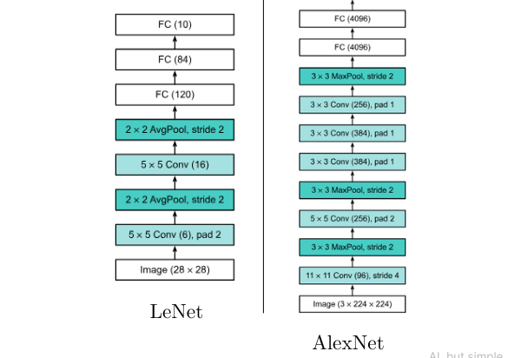
CNN Models-LeNet vs AlexNet Architecture
Modern Convolutional Neural Network Architectures

Slide 39
CNN Models
VGGNet by Visual Geometry Group (VGG)
Small 3x3 filters are used in all convolutional layers of VGGNet which increases the network's depth and captures more complicated information.
There are two variations of VGGNet, with 16 and 19 weight layers, respectively: VGG16 and VGG19. Multiple convolutional blocks make up the network's architecture, which is then followed by max pooling layers, fully connected layers, and a softmax layer for classification.
The University of Oxford's Simonyan and Zisserman presented VGGNet in their paper "Very Deep Convolutional Networks for Large Scale Image Recognition." On ImageNet, a large picture dataset with 1000 classes, it obtained 92.7% top-5 test accuracy.
Used to detect large-scale images

Slide 40
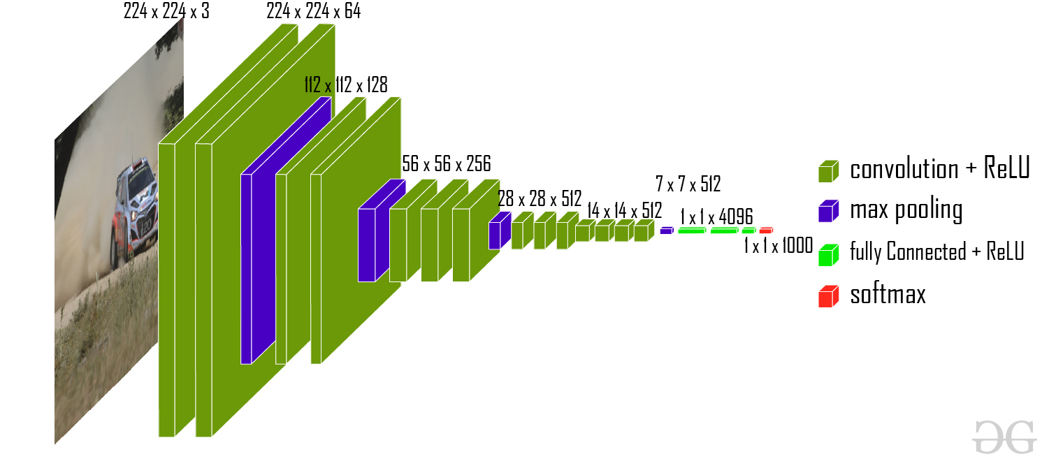
CNN Models-VGGNet Architecture

Slide 41
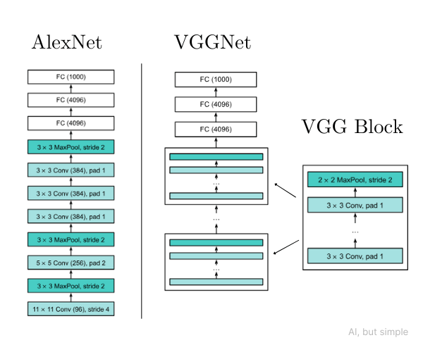
AlexNet vs VGGNet

Slide 42
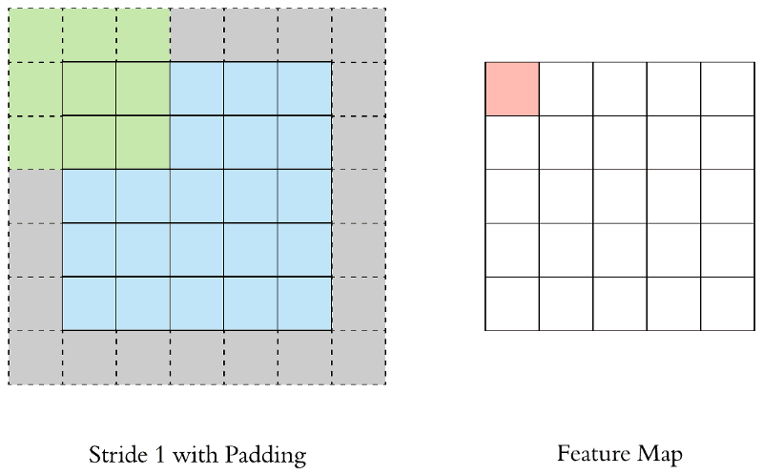
VGG Block
A VGG block consists of a sequence of convolutions with 3×3 kernels with padding of 1 (maintaining the height and width) followed by a 2×2 max-pooling layer with stride of 2 (halving the height and width).

Slide 43
CNN Models
ResNet
Winner of ImageNet Competition 2015.
Addresses the issue of vanishing/exploding gradients in very deep networks by using residual blocks with skip connections.
Instead of learning the direct mapping between a layer's input and output, residual blocks enable the network to learn the residual mapping. This improves the accuracy and ease of network optimization.
Skip connections combine the output of the preceding layer with the output of the subsequent layer, so avoiding one or more levels. This promotes gradient flow across layers and information preservation.

Slide 44
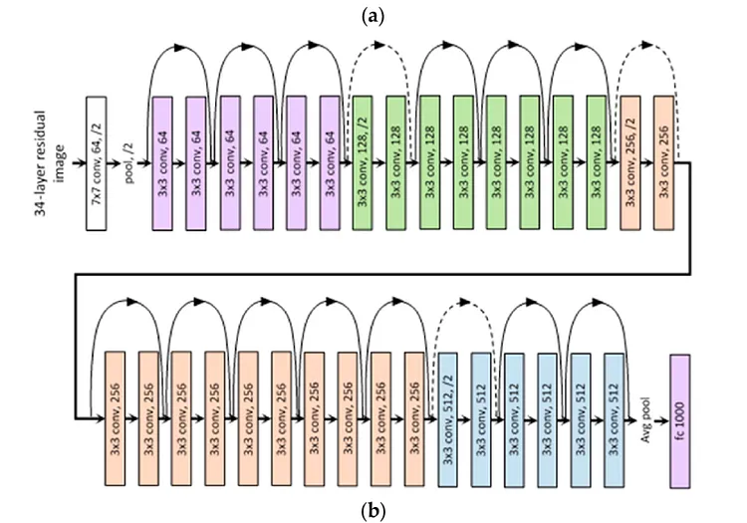
CNN Models-ResNet 34 Architecture

Slide 45
CNN code using Tensorflow
import tensorflow as tf from tensorflow.keras import datasets, layers, models import matplotlib.pyplot as plt
train_images, train_labels), (test_images, test_labels) = datasets.cifar10.load_data() # Normalize pixel values to be between 0 and 1 train_images, test_images = train_images / 255.0, test_images / 255.0

Slide 46
CNN code using Tensorflow
class_names = ['airplane', 'automobile', 'bird', 'cat', 'deer', 'dog', 'frog', 'horse', 'ship', 'truck'] plt.figure(figsize=(10,10)) for i in range(25): plt.subplot(5,5,i+1) plt.xticks([]) plt.yticks([]) plt.grid(False) plt.imshow(train_images[i]) # The CIFAR labels happen to be arrays, # which is why you need the extra index plt.xlabel(class_names[train_labels[i][0]]) plt.show()

Slide 47
CNN code using Tensorflow
model = models.Sequential() model.add(layers.Conv2D(32, (3, 3), activation='relu', input_shape=(32, 32, 3))) model.add(layers.MaxPooling2D((2, 2))) model.add(layers.Conv2D(64, (3, 3), activation='relu')) model.add(layers.MaxPooling2D((2, 2))) model.add(layers.Conv2D(64, (3, 3), activation='relu'))
model.add(layers.Flatten()) model.add(layers.Dense(64, activation='relu')) model.add(layers.Dense(10)
model.summary()

Slide 48
CNN code using Tensorflow
model.compile(optimizer='adam', loss=tf.keras.losses.SparseCategoricalCrossentropy(from_logits=True), metrics=['accuracy']) history = model.fit(train_images, train_labels, epochs=10, validation_data=(test_images, test_labels))

Slide 49
CNN code using Tensorflow
plt.plot(history.history['accuracy'], label='accuracy') plt.plot(history.history['val_accuracy'], label = 'val_accuracy') plt.xlabel('Epoch') plt.ylabel('Accuracy') plt.ylim([0.5, 1]) plt.legend(loc='lower right') test_loss, test_acc = model.evaluate(test_images, test_labels, verbose=2)

